Slide 1

Centre for Project Management
Welcomes you to
Post Graduate in Advanced Project Management
Batch 33 – PG-APM
Notes:
NTCP Framework of some groups (3 – 4)
(15 min – 20 min)

Slide 2
Strategy to Projects
What is strategy
  Strategy, quite simply, even in its simplest form indicates a preferential path which we will like to follow to reach a goal/objective.
Vision and Mission
  This is guided by the Vision (where we will like to reach) and the Mission (what we are or what we do).
Should project have its own objective and vision ?
Notes:
List at least 2 strategic projects of your organization
Your company vision and mission
(5 minutes)

Slide 3
Source : https://www.tmetc.com/about-us/mission-vision-culture-values.aspx
Mission & Vision
Mission : We innovate mobility solutions with passion to enhance the quality of life.
Vision : By FY 2024, we will become the most aspirational Indian auto brand, consistently winning, by
  Delivering superior financial returns
  Driving sustainable mobility solutions
  Exceeding customer expectations, and
  Creating a highly engaged work force

Slide 4
Portfolios of Tata Motors
Tata Motors projects
- Tata Pixel zero turn_x000b_ demonstrator
- Tata Ace EV development
- Tata Vista EV development
R&D collaborations
- LowCAP project
- CABLED project
- LCVTP programme
- E-Future
External customer projects
Source : https://www.tmetc.com/portfolio/tata-vista.aspx

Slide 5
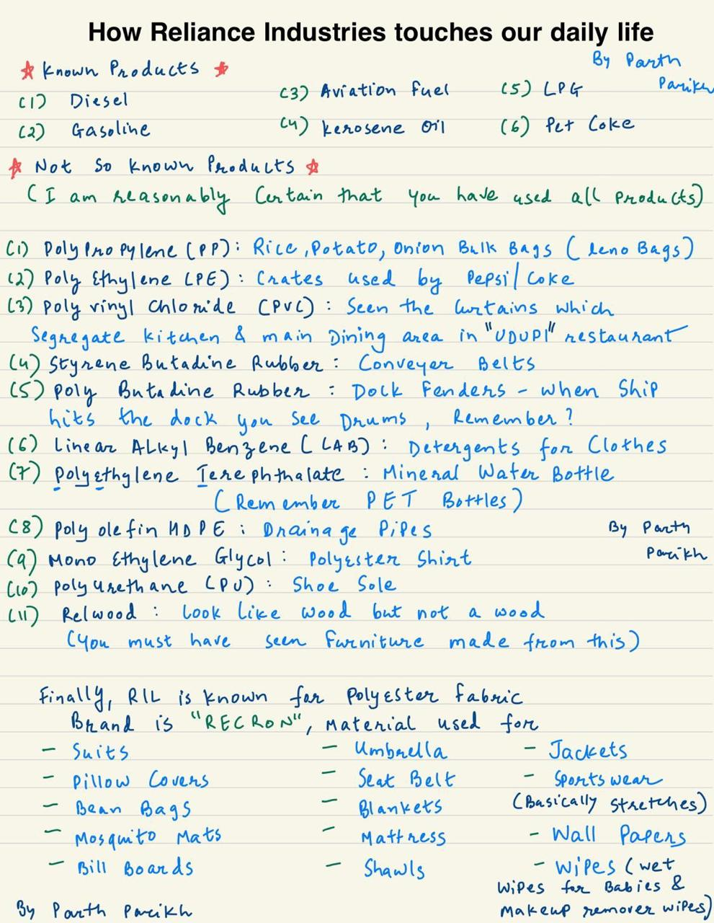
Post from LinkedIn,
Value Chain of Petrochem Projects
Witten by Parth Parikh
Petrochemicals
Our petrochemicals business creates more than just products, it generates experiences that shape and enhance lifestyles.
It is our constant endeavor to develop products that provide world-class experiences to our customers across a range of applications – packaging, agriculture, automotive, housing, and healthcare among others.
Our comprehensive solutions such as project identification, new product design, product and market development, raw material selection and testing – beside a host of 'industry specific' solutions – have helped us grow into the world's largest integrated producer of polyester fibre and yarn. Reliance continues to set global benchmarks in product quality, standards and services. Superior technologies, strong focus on R&D, latest IT-enabled services and end-to-end solutions across the value chain reinforce our leadership in the industry.
https://www.ril.com/OurBusinesses/Petrochemicals.aspx

Slide 6
External Environment
Organizational culture
Vision
Implementation
Alignment
Innovations
Mission
Strategy
Organizational Strategy & Objectives
Portfolios, Programs & Projects
OPM

Slide 7
Strategic nature of Modern project management
There has been widespread growth of modern project management and its use is increasing in newer and non-traditional sectors.
The concept of “Managing by projects” is also taking root in many operational organizations.
  Strategic Planning
  Capital Budgeting
  New Product development
  Organizational change
  Mergers and Acquisitions
  Outsourcing
  Process Improvement
  Cost Reduction
  Digital Transformation

Slide 8
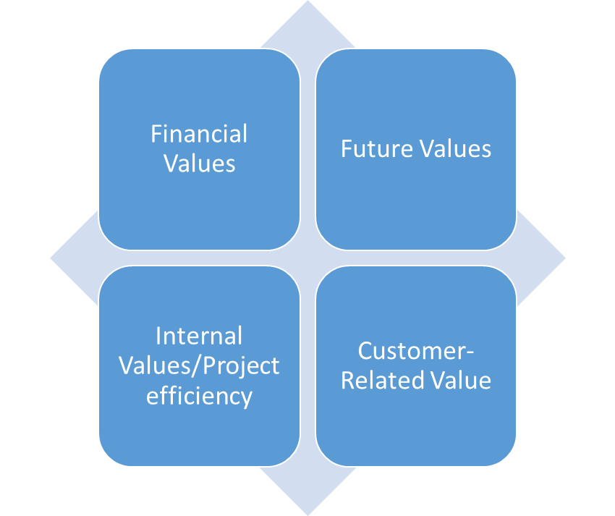
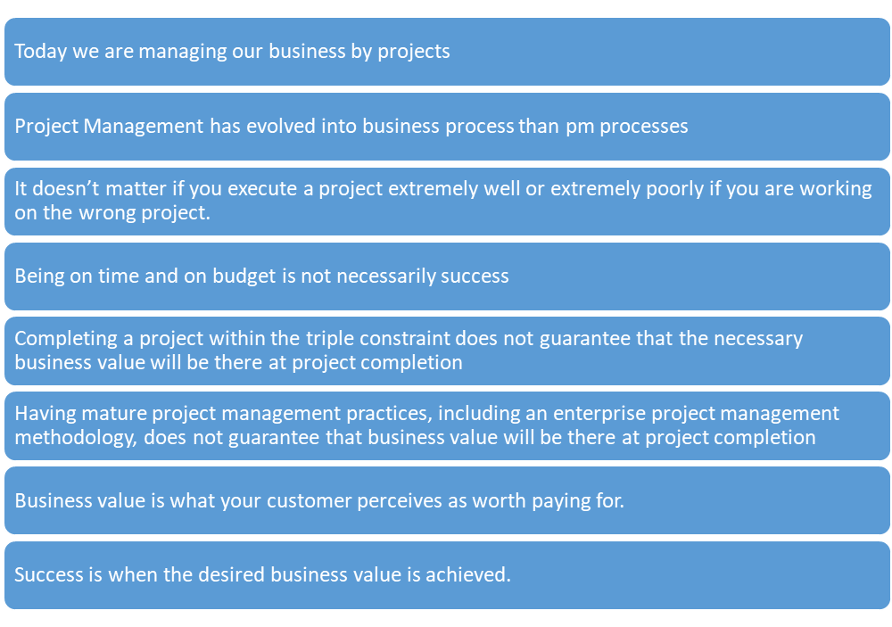
Value-driven Project Management
Achieving the desired business value within the competing constraints
Categories of Project / Business Value

Slide 9
How to align your Project to Business Strategy
Using it we are able to choose the ‘right projects rather than just do the projects right.
Why | Benefits
One way to ensure you sit at the table and not wait for the annual report | Allows you to speak the language of the Business
Mechanism to map your project and support strategic goals | Contribute to Corporate Vision
Anticipate Market Trends Quickly respond to market changes and world events | Become Agile and Competitive
How?
Review all strategic goals for business strategy and portfolios
Develop a systematic approach to initiate and prioritise projects to Align it to business strategy
Evaluate and repeat on a regular basis

Slide 10
Strategic Project Management
Growing trend
Deal with the business aspect of project to support company strategy
Strategy without projects is just a useless doc collecting dust
Projects without strategy are waste of time and actions losing their appeal.
Notes:
Strategic project management is becoming a popular and growing trend within the project management discipline.
According to the main idea of the concept, project management teams must learn how to deal with the business aspects of their projects and better support their company’s strategy, rather than just be focused on meeting traditional issues – time, budget, and goals.
Project management is the process that controls a project from its start to finish. Strategy without projects is just a useless doc collecting dust. Projects without strategy are waste of time and actions losing their appeal. Strategy shapes decisions about products. A strategy that cannot be applied to work has no value.

Slide 11
What is Strategic Project Management
Big Picture
Helps in setting right priorities
  Simplifying decision making
  Setting priorities permanently
  Energy prioritization
  Linking budgets to strategy
  Prepare your self to contribute to the project strategy
  Focusing on organizational ambitions
  Revisiting Strategic progress
Source : Strategic Project Management (Paul Roberts)
Notes:
Strategic Project Management (SPM) defines the big picture of how the project may benefit the company’s efficiency and as a whole. This process combines business strategy and project management methodologies and techniques to deliver organizational breakthroughs.
It accelerated by brainstorming and problem-solving activities so that a project will not only be completed successfully but more efficiently and faster.
Simplifying decision-making. If there is a clear strategy, then decision making becomes easier.
Setting priorities permanently. It’s a good idea to start every day with priorities but not with emails. By starting the day with email, you focus on urgent things instead of the important. Start the day by developing one task that will advance your strategy.
Energy prioritization. Most people tend to have more energy in the morning before the power is consumed. Scheduling work on your strategic priorities in the morning will improve total results. Projects usually depend on enthusiasm, problem solving and creativity, so ignoring energy levels will definitely lead to failure.
Linking budgets to strategy. Allocating required budget is a clear signal of the company’s priorities. If you’re managing a project management office, the strategy must guide your decisions.
Preparing yourself to contribute to the project strategy. Most of the high-performing companies call on their project management offices to contribute to strategic planning. If you’re a growing project manager, you may have limited input on strategy today. Therefore, you need to educate yourself and be prepared.
Focusing on organizational ambitions. Of course, people want to be recognized and admired for their work. However, some managers seek personal glory at the cost of the company. Seek out what the company needs and fight the urge to focus solely on problems or challenges you encounter.
Revisiting strategic progress. Often, the strategy is an annual exercise in companies. For a few days or weeks, a great deal of energy goes into developing the document. All that effort goes to waste unless you revisit the strategy and measure progress. Measuring progress should not be complicated. Just add an agenda item to your weekly meeting to review the strategy.

Slide 12
SWOT Analysis What and Why
SWOT analysis for project management is a simple, yet effective process.
It allows the project manager to identify areas that needs improvement.
By implementing the correct methodologies for the analysis, it is possible to ensure that a project will be completed on time and within budget.
SWOT stands for Strengths, Weaknesses, Opportunities and Threats.
Source : https://project-management.com/why-you-should-do-a-swot-analysis-for-project-management/

Slide 13
Conducting the SWOT Analysis
Clear Objective of your project
Stakeholder Expectations
Common questions related to Strengths, Weakness, Opportunities and Threats

Slide 14
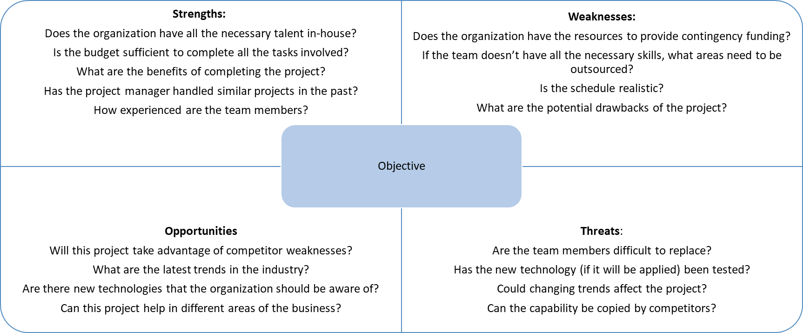
Common Questions

Slide 15
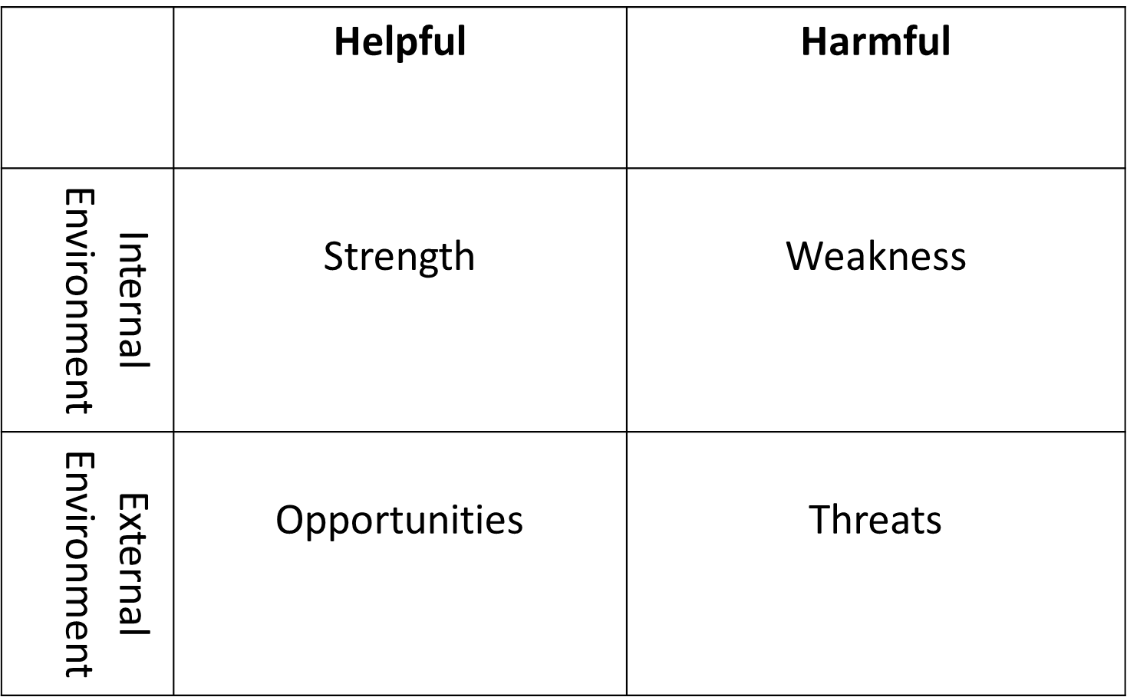

Slide 16
SWOT ANALYSIS – An Example
STRENGTHS
Large manufacturing & Execution capacities
Proven In-house Design and Testing capability
Experience of working in difficult and diverse terrains
Ability to mobilize resources for large project execution
Pre-Qualification and global presence
Relationships across Customers & Vendors
WEAKNESS
Qualification for infrastructure projects
Working capital management
IT & Systems
Construction tools & technologiy
OPPORTUNITIES
Huge Investment outlay in Transmission sector by Central and State Utilities during 11th and 12th plan
PPP Model being adopted by State utilities
BOO projects in transmission on tariff based bidding
Increasing Private Developers in Generation & Transmission
THREATS
Emergence of smaller players with aggressive strategies
Rapidly changing competitive landscape & Business Scenario
Increased participation of foreign companies in funded jobs

Slide 17
Case Study

Slide 18
Project objective
Desired results of the project
SMART objective
A project may have one objective
Many parallel objectives
Several objectives

Slide 19
Examples of Project objective
Poorly Written Objectives
  Personal: Earn more money.
  Personal: Go to university.
  Nonprofit: Help children read better.
  Business: Create a new app.
  Business: Install a new system.

Slide 20
Examples of Well Written Objectives
Personal: Your goal may be to buy a house, but your objective is to get a condominium for under $250,000 with two bedrooms by August.
Business: The goal is to build up the company in the near future. The objective is to increase sales of Super Widget by 10 percent by the second quarter of next year.
Business: The goal is to make existing customers happier. The objective is to improve customer satisfaction rates by 50 percent by June 30 through training of customer service team.
Nonprofit: The goal is to restore a native habitat around the retention pond near the Old Road to encourage native bird and animal species to visit and improve water filtration. The objective is to support residential homeowners around the pond to remove and replace non-native plants on one-third of the designated area by December.
Nonprofit: The goal is to ensure that homeless women have access to regular meals. Three objectives can help accomplish this goal:
  Objective 1: To locate a kitchen and eating space on a bus route that can serve 30 women by December 15.
  Objective 2: To recruit volunteers who will staff the kitchen for breakfast and dinner by December 30.
  Objective 3: To organize a regular donated food supply for breakfasts and dinners from local organizations and restaurants by December 30.

Slide 21
Benefits
Affects every step in a project life – cycle
Team understands what they are working towards

Slide 22
Business Case
What is the business case?
The business case captures the reasoning for initiating a project or task. It is the information needed for authorisation of the project.
What is the purpose of the business case?
Why use business case analysis?

